Slide 1
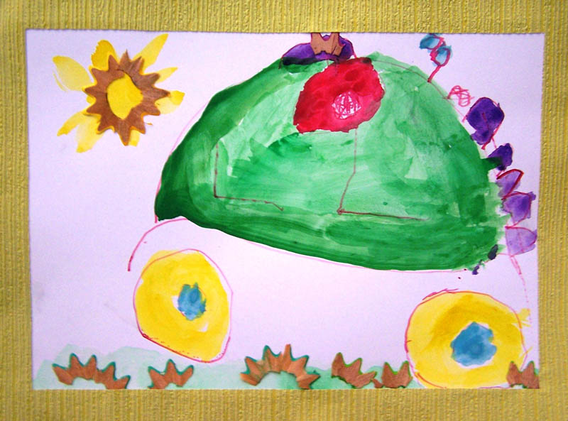
KINDERGARTEN JESTŘABÍ LHOTA
Bc. Romana Balounová

Slide 2
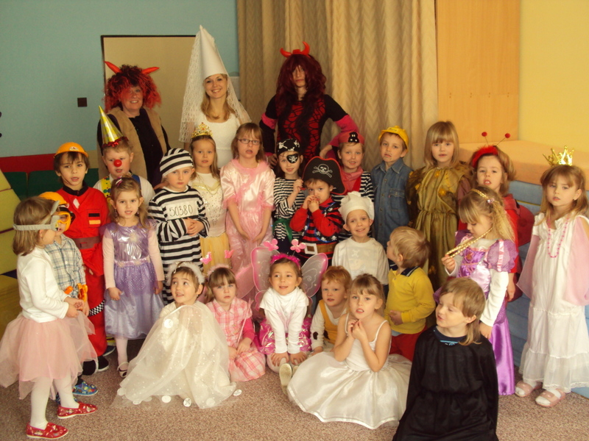
Our Kindergarten – basic information
The school building is in an old house.
Our kindergarten is there for 36 years.
I work as a director for 5years in Jestřabí Lhota,
which is a small village near Kolín.
In the school there are four members of staff and 25
children.

Slide 3
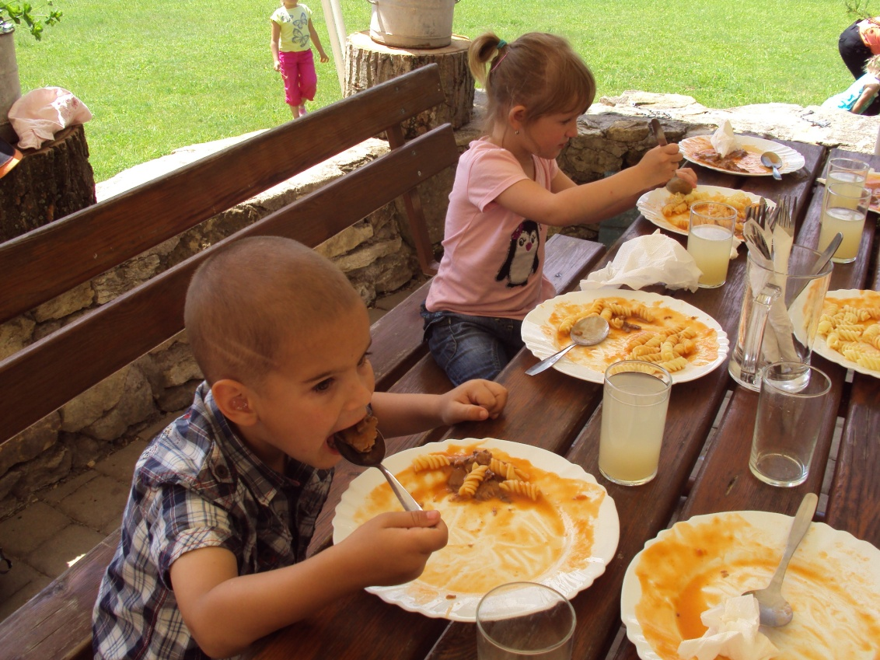
Every day we do exercise, sing, draw, play a fairy tale, listen to music and GO TO THE GARDEN!!!
Aunt cook cooks many good meals: soups, fish or meat, rice and cakes too.
Kids always have fruits and vegetables on tables.

Slide 4
I think our children are happy.
We sometimes go to the cinema or theatre.
They have many toys, beautiful school and super teachers.

Slide 5
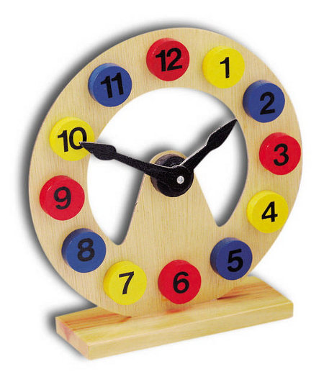
Typical day in the kindergarTen is from half past six to four.
Kids come to school in the morning by eight o’clock.
They play with toys, draw and speak with friends or their teacher.

Slide 6
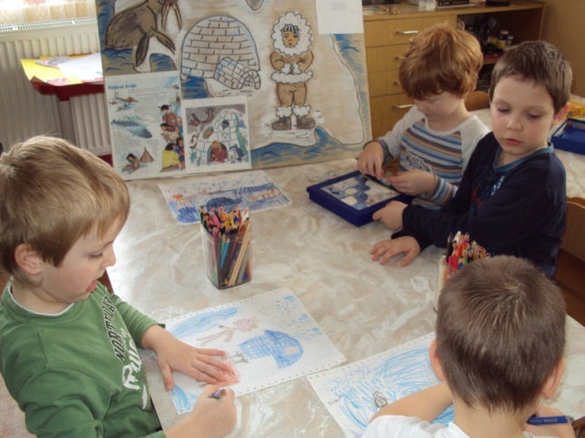
We do exercise with music, with toys, balls… it depends. Kids like to play sports games.
At half past eight we do exercise.
Then we have a snack.
Kids drink water, tea or milk, eat bread, fruits and vegetables.
After snack:
kids sing and listen to music play a fairy tale or produce something.

Slide 7
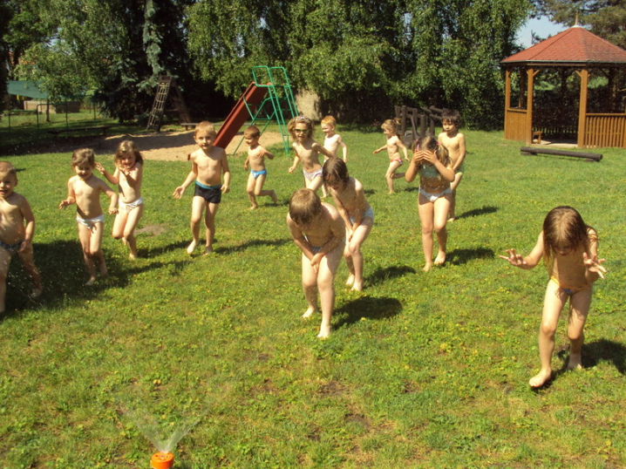
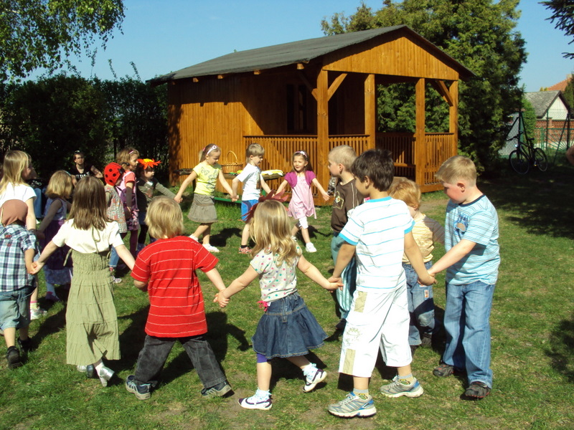
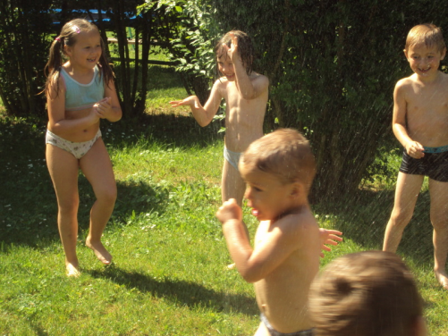
Before lunch we go to the garden or go for a walk.
We have a beautiful garden and many toys.
Kids like to work out.

Slide 8
At noon we have lunch together in the dining room. After lunch some kids go home and some kids go to sleep. The teacher reads a fairy tale and kids relax.

Slide 9
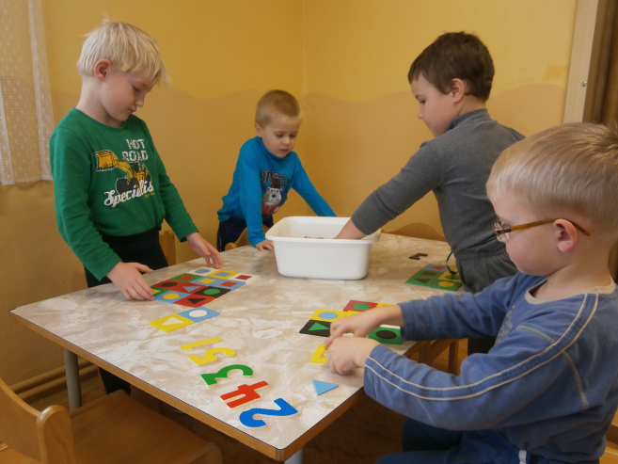
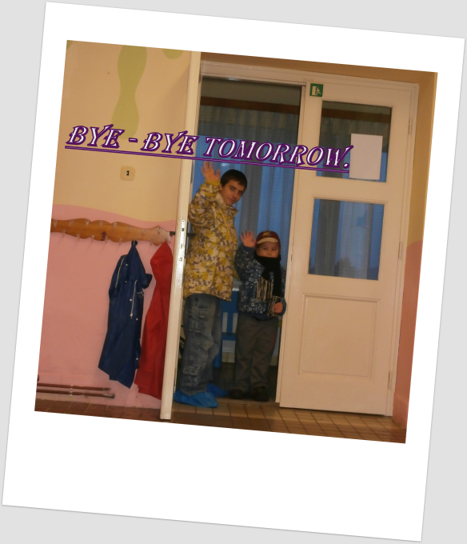
In the afternoon we learn trough playing.
The oldest kids prepare for school.
They have exercise books.
All kids get up and they have a snack.
After snack kids play and go home with their parents.
Time is up. It is four o’clock.

Slide 10
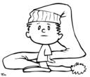
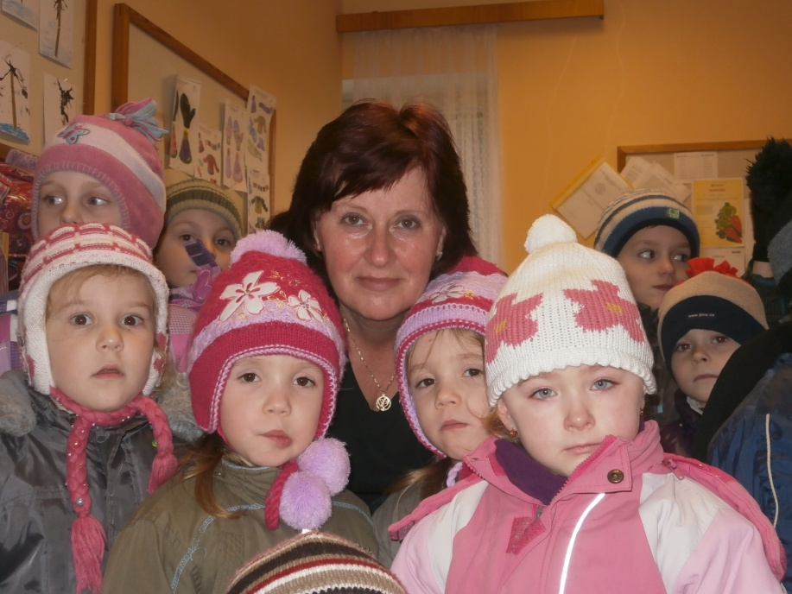
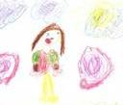
The rules in the kindergarden
Kids make rules together.
What is it good for?
Children remember the rules better.
+When one speaks the other
listens.
+They must clean toys and then
they may take other toys.
+Before lunch kids must wash their
hands.

Slide 11
In the kindergarden parents have rules too. Kids should come to school in the morning by eight o´clock. Parents must give their kids clean clothes. They mustn´t smoke in the kindergarden.
There are rules for the staff, too. There is no other way. The school keeper must help the teacher with dressing the kids in the cloak-room. The cook mustn´t cook unhealthy food.

Slide 12
The teacher mustn´t shout at kids and the director must be a good example for the children. She shouldn´t smoke, eat unhealthy food and she must have clean clothes too. There is no other way.
THANK YOU, BYE

